Slide 1

PARLIAMENTARY POSITION HELD BY WOMEN IN MIDDLE EASTERN COUNTRIES.

Slide 2
TABLE OF CONTENT
INTRODUCTION
RESEARCH QUESTION
DATA CLEANING
VISUALIZATION
CONCLUSION

Slide 3
INTRODUCTION
From 2015 to 2022, despite a diverse population, women's representation in Middle Eastern parliamentary roles has remained stagnant or decreased. This period highlights the struggle to bridge the gap between population demographics and political representation.

Slide 4
RESEARCH QUESTION
Investigate the extent of the gap between the population and women's representation in parliamentary positions across various Middle Eastern countries from 2015 – 2022.
Analyze the specific countries within the Middle East where the decrease or stagnation in women's parliamentary representation is most pronounced.
The quick diminish of growth in these Middle Eastern countries from 2015 - 2022

Slide 5
DATA CLEANING
The data comprises two datasets: "Parliament Positions Held by Women" and Population data.
To enhance my skills, I employed Python, Excel, and SQL for data wrangling and cleaning.
Firstly, I tailored the data to match the question's criteria, focusing solely on Middle Eastern countries spanning 2015 to 2022.
Subsequently, I standardized entries in the country column to ensure consistency for later data merging and to mitigate issues like duplications and null values.
Additionally, I validated and corrected data types to ensure accuracy.
Duplicates were meticulously reviewed and removed, while certain columns were excluded from analysis due to their limited relevance.

Slide 6
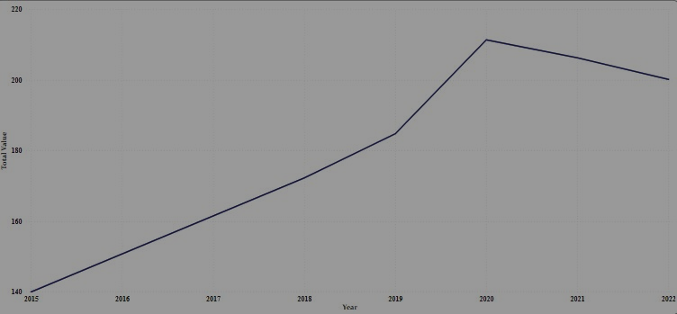
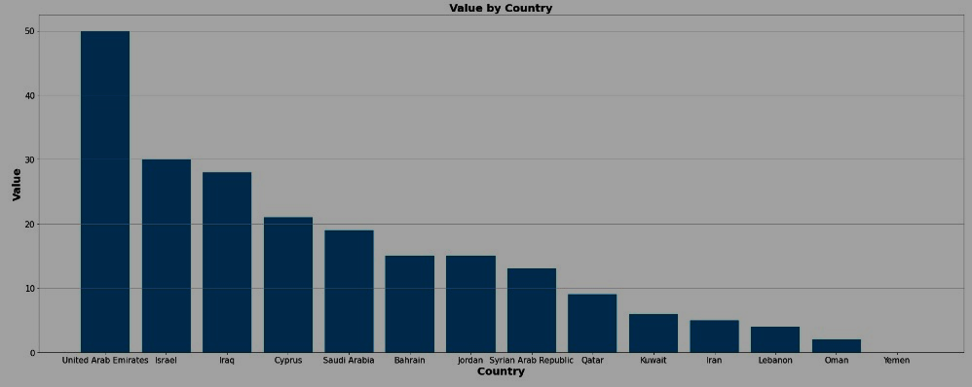
VISUALIZATION
In the UAE, the growth of women in parliamentary positions is impressive, increasing from 18 in 2015 to 50 in 2022, showcasing progress despite cultural factors. Similar trends are seen in Israel, Iraq, Cyprus, Bahrain, and Saudi Arabia, but Qatar's drop to 4 and Kuwait's decline to 2 by 2022 are concerning. Surprisingly, Yemen has very little percentage of women in parliament from 2015 to 2022, potentially due to legal and cultural barriers despite international commitments

Slide 7
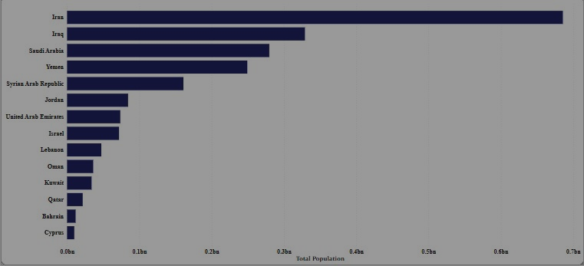
The Middle East analysis reveals that from 2015 to 2022, UAE, despite its diverse beliefs, saw 213 women hold parliamentary positions among its total population of 55,362,288. In contrast, Israel and Iraq, with populations of 54,447,300 and 250,498,731 respectively, had 159 women each in such positions. Oman, with a population of 27,035,869, had 11 women representatives, while Yemen had only 1, emphasizing significant population disparities in parliamentary representation.
VISUALIZATION

Slide 8
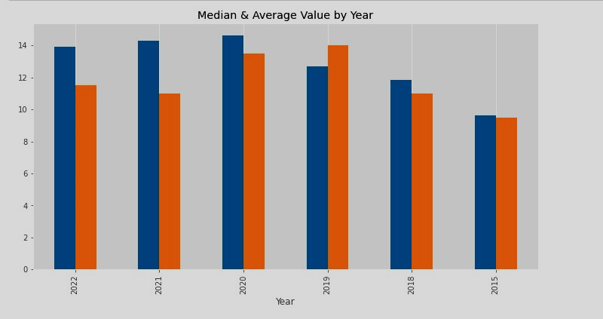
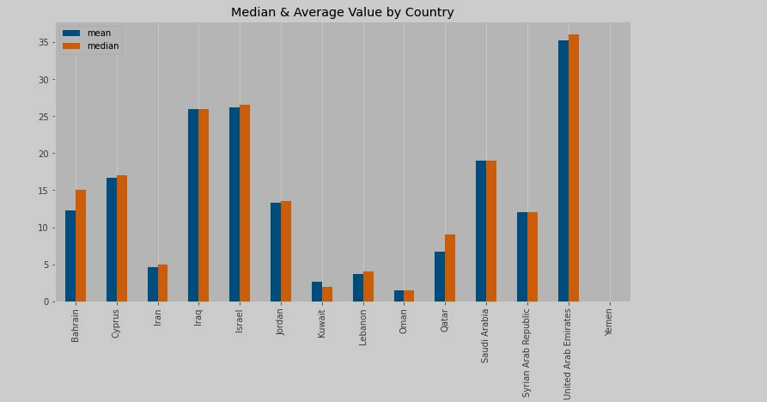
VISUALIZATION
The information shows that UAE has the most women in parliamentary positions on average and in the middle (35 and 36), then Israel and Iraq (27 and 26). Yemen has none on average. In 2020, there was improvement, but by 2022, the numbers dropped by 10. This data highlights how women's voting rights matter as the world modernizes.

Slide 9
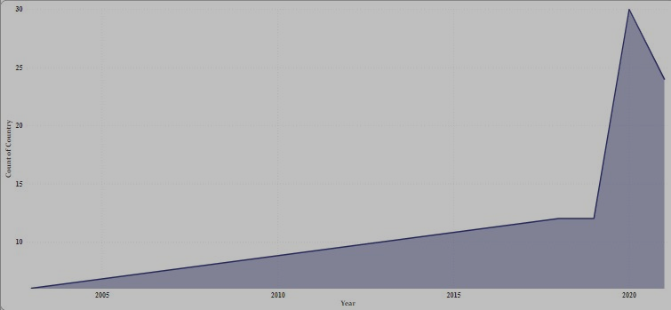
VISUALIZATION
The most recent election in the UAE with the highest total of 213 women was in October 2019, whereas in Yemen, the last election was held in April 2003, resulting in a total of 1 woman elected.

Slide 10
CONCLUSION
In conclusion, the analysis of women's parliamentary positions in Middle Eastern countries from 2015 to 2022 underscores both progress and challenges.
While countries like the UAE, Israel, and Iraq have shown notable increases in women's representation, disparities remain stark.
The dataset highlights the complex interplay of cultural, legal, and societal factors impacting women's involvement in politics.
As the world continues to evolve, the dataset serves as a reminder of the ongoing importance of promoting and safeguarding women's rights and representation in political decision-making processes.
Women are the largest untapped reservoir of talent in the world.
Hillary Clinton

Slide 11
REFERENCES
https://www2.ohchr.org/english/bodies/hrc/docs/ngos/Yemen's%20darkside-discrimination_Yemen_HRC101.pdf.
Kaggle.com/dataset

